Slide 1
When the Rebel Heart Needs the Blackheart
Shipping the professional wrestlers Tommaso Ciampa and Johnny Gargano
CarrieLynn D. Reinhard, Dominican University

Slide 2

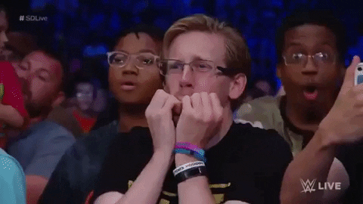

Defining Pro Wrestling
Kayfabe: convergence of reality and fiction
  Performance of fake as if real
  Scripted “sports entertainment”
  Wrestlers as actors, storytellers as well as athletes
Kayfabe as co-constructed
  Audience performs role of reinforcing kayfabe

Slide 3

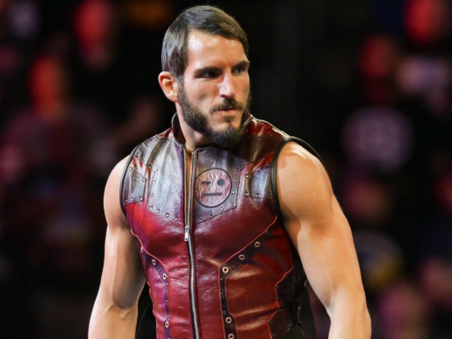
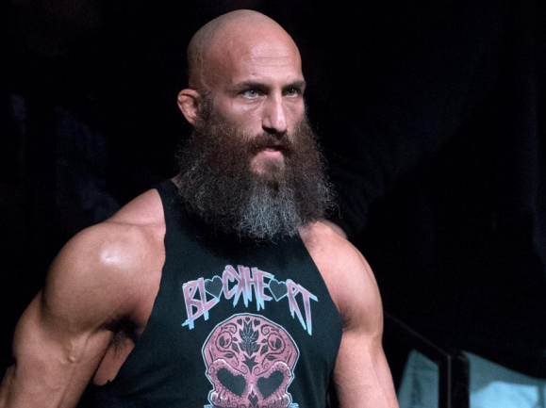
Importance of NXT
NXT: WWE Developmental
  Started in 2010
  Became popular among smart wresting fans in 2014
Two main wrestlers studied joined in 2015
  Johnny Gargano aka “Rebel Heart”
  Tommaso Ciampa aka “Blackheart”
Started seeing fanfiction in 2016, shipping them as lovers

Slide 4

EDR Model
Encoding
  Producers, living within society/culture, create media texts that embody sociocultural values, memes, ideologies
Decoding
  People, living within same/different society/culture, interpret media texts with varying degrees of accepting encoded messages (dominant, negotiated, oppositional)
Recoding
  People use media texts in own lives to understand, reflect and/or challenge society/culture
Assumption 1: Can examine fans’ recoding to understand their decoding.
Assumption 2: Can plot recodings historically in relation to encodings to understand changes in decodings.

Slide 5
Encoding
Emotional Storyline + Multi-year 3-Act Play
  Strangers Team Up (Sept. 2015-May 2016)
  Cruiserweight Challenge (June 2016)
  #DIY as Underdogs (Aug. 2016-Apr. 2017)
  Blackheart Turns Heel (May 2017-Dec. 2017)
  Torturing Rebel Heart (Jan. 2017-Nov. 2018)
  Dark #DIY (Dec. 2018-Mar. 2019)
  Blackheart Black Out (Apr. 2019-Sept. 2019)
  Daddy Returns for Goldie (Oct. 2019 – Jan. 2020)
  Face of the Brand (Feb. 2020-Apr. 2020)
  Going Separate Ways (May 2020-present)

Slide 6
Encoding
Setting emotional tone (2015-2017)
  Performances in-ring include:
    Intense eye contact
    Hugging
    Arms around each other
    Cradling head to chest
    Rustling hair
  Commentator Rhetoric includes:
    Reunited
    Chemistry
    Long-time friends
    Cinderella story
  Promo character Rhetoric includes:
    Good friend
    Brother
    Family
    Love

Slide 7
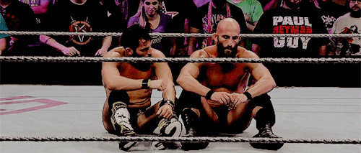
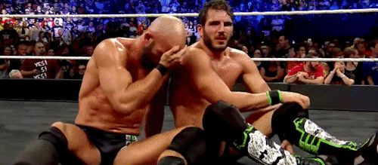
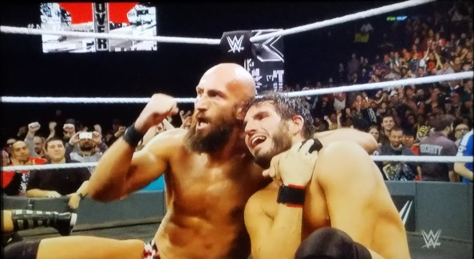
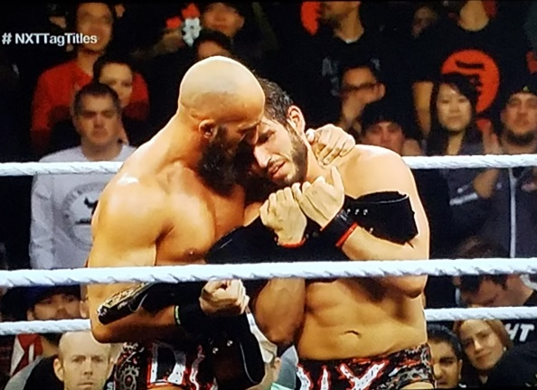
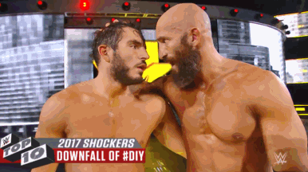
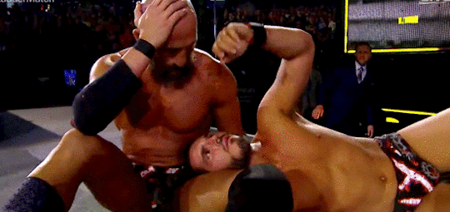
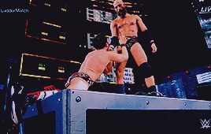

Slide 8
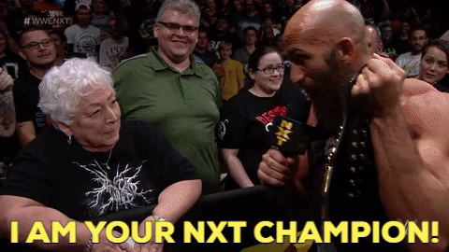
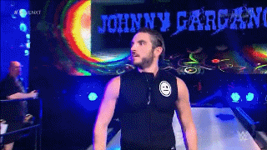
Decoding
Reactions of Live Crowds
  Johnny as face, Tommaso as heel
  From cheers to boos to cheers again
Such reactions not entire story
  Perhaps more performance than authentic

Slide 9
Ciampa/Gargano on AO3
As of May 30th 2021, 69 stories
Total comments: 446
Total kudos: 2041
Total Hits: 32,391
Most common tags: Hurt/Comfort, Fluff, Friends to Lovers, Happy Ending, Alternate Universe, Angst, Enemies to Lovers, Kayfabe Compliant, Threesome, First Kiss
Stories tend to portray
Gargano as sweet, innocent, emotional, feminine, submissive, bottom
Ciampa as stoic, bitter, pained, aggressive, dominant, top

Slide 10
Recoding
Stories to deepen their kayfabe relationship
  Story: “Phone Tag” as response to NXT 8/31/16 episode where Tommaso was attacked without Johnny around
  Story depicts them arguing about their relationship with each other, and ending up spooning in bed
  One reader’s response: “Awwww. <3 I love how much they both want to look out for each other but are just having a hard time.””

Slide 11
Recoding
Stories to restore their kayfabe relationship
  Story: “(Re)do It Yourself”
  From author: “now as im posting this ciampa is getting neck surgery and i am crying :/ im just gonna pretend that real life and the main roster fuck ups don't exist and that weird heel diy is still on nxt and thriving i love them so much my heart is so full of love for those boys :’)”
  Story attempts to rebuild Ciampa/Gargano assumed “marriage” after betrayal

Slide 12
Decoding
Reactions of Fanfic Writers at Archive of Our Own (A03)
  “They are such a criminally underutilized pairing! I mean come on, the tension on screen is ridiculous!”
  “I need more Ciampa & Johnny drama. They’re too perfect for each other.”
  “People dealing with betrayals and complicated emotions is one of my favorite things about wrestling, so this entire Ciampa-Gargano storyline has been a gift…”
  “Tommaso and Johnny are breaking my heart lately (come back and break it in person, Tommaso!) so I'm happy to share the heartbreak!”
  “They're all dragging each other in different directions and I know it's not going to end well, but I can try to give them a vaguely uneasy midground, haha.”
  “Gosh i love these two fucked up assholes”

Slide 13
Encoding Meets recoding
Strangers Team Up | Cruiserweight Challenge | #DIY as Underdogs | Blackheart Turns Heel | Torturing Rebel Heart | Dark #DIY | Blackheart Black Out | Daddy Returns for Goldie | Face of the Brand | Going Separate Ways
Sept. 2015-May 2016 | June 2016 | Aug. 2016-Apr. 2017 | May 2017-Dec. 2017 | Jan. 2017-Nov. 2018 | Dec. 2018-Mar. 2019 | Apr. 2019-Sept. 2019 | Oct. 2019-Jan. 2020 | Feb. 2020-Apr. 2020 | May 2020-present
 |  | 16 fanfics | 9 fanfics | 15 fanfics | 10 fanfics | 7 fanfics | 3 fanfics |  | 9 fanfics
Built foundation via emotional cues (16 stories)
Majority attempting to reconcile after break-up (34 stories)
Less interested in Gargano as aggressor (19 stories)

Slide 14

Analytical Conclusions
Encoding sees homosocial relationship that challenges gender stereotypes.
Decoding involves emotional reactions to emotional story cues.
Recoding operates as relationship maintenance.
1st: explain homosocial, nonstereotypical relationship
2nd: repair bonds of broken relationship

Slide 15
What Does This Mean?
EDR model application to fan studies as possible means understand relationship between text and reception.
E/D/R model analysis suggests support for NXT displaying non-traditional pro-wrestling relationship
Stories to support development of relationship
Stories to repair the relationship
But Gargano as aggressor less interesting
From beginning, Ciampa positioned as more aggressive, even when initiating positive physical contact
Gargano as aggressor not aligned with fans’ headcanon, expectations
Stories post-Gargano heel turn retain focus on Ciampa as aggressor

