Slide 1

The positioning of Pooky:
A semi-professional's utilization of a virtual world for experimenting with television
CarrieLynn D. Reinhard,
Dominican University
www.playingwithresearch.com
@MediaOracle
Pooky Amsterdam,
PookyMedia
www.pookymedia.com
@PookyMedia

Slide 2

Virtual Worlds Television
Interactive television
  Beyond control when/where/how access
Potential for content interactivity
  Impacting progression of content
"Inhabited Television" (Benford et al 1999; Craven et al 2000)

Slide 3
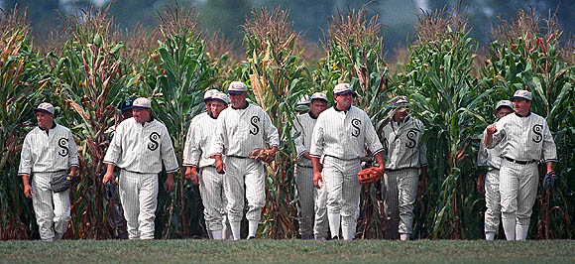
VWTV & Web 2.0 Paradigm?
“Build it, and let them create”

Slide 4
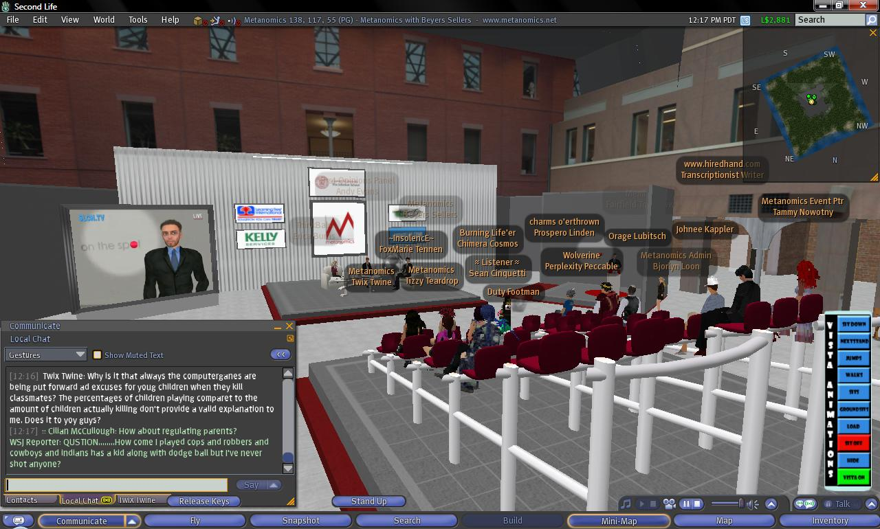
VWTV: Metanomics (Bloomfield, 2007)

Slide 5
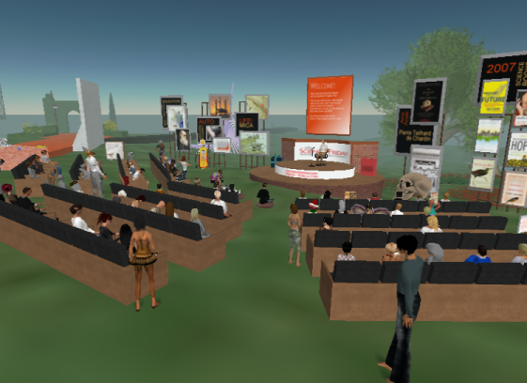
VWTV: Science Friday (Flatow, 2007)
Courtesy: http://guysoft.wordpress.com/2007/12/08/a-podcast-in-second-life/

Slide 6

The Study
Relationship of “build it, and let them create”
  To Web 2.0 paradigm
  To traditional producer-audience relationship
As seen in positionings of virtual worlds television entrepreneur Pooky Amsterdam

Slide 7
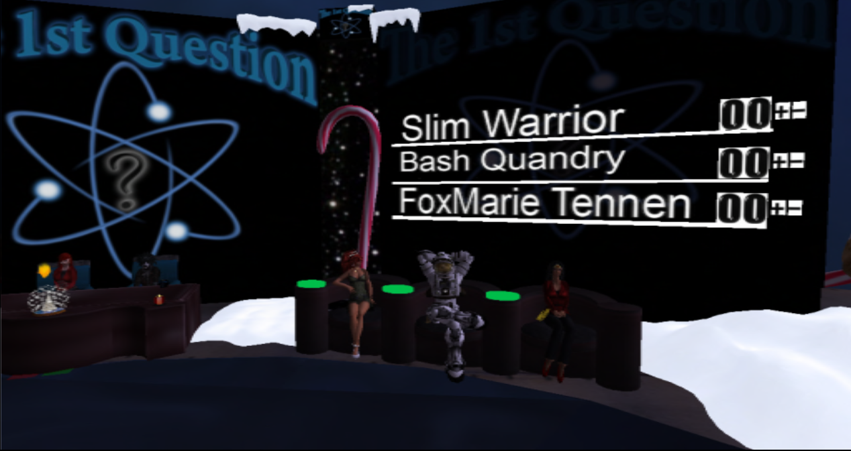
Pooky Amsterdam & PookyMedia
The First Question

Slide 8
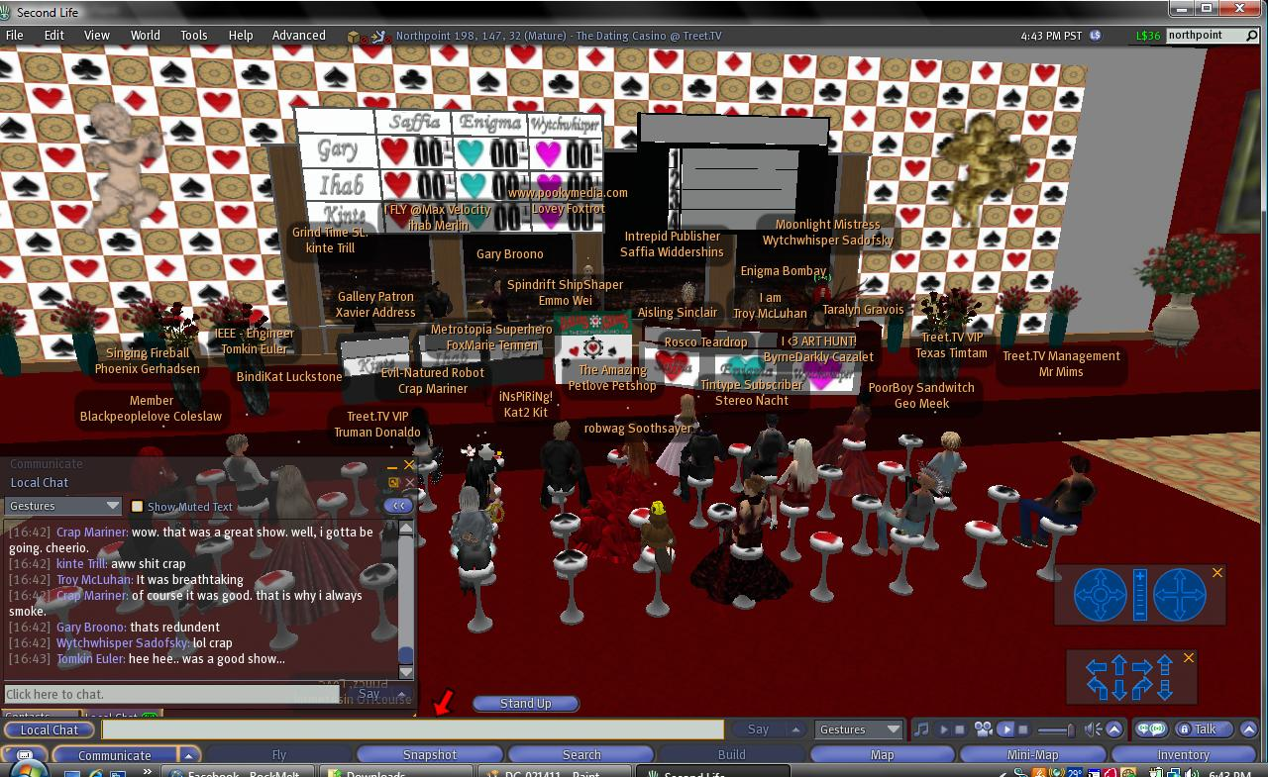
Pooky Amsterdam & PookyMedia
The Dating Casino

Slide 9
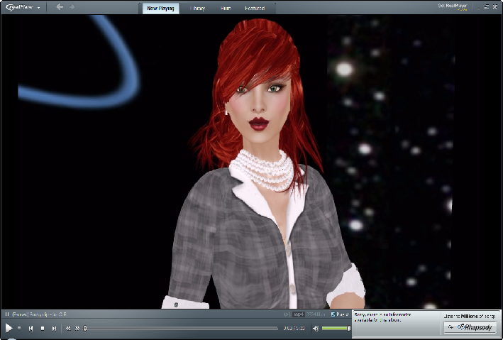
The Study
Tensions in how described herself, relationship to audience & virtual worlds

Slide 10
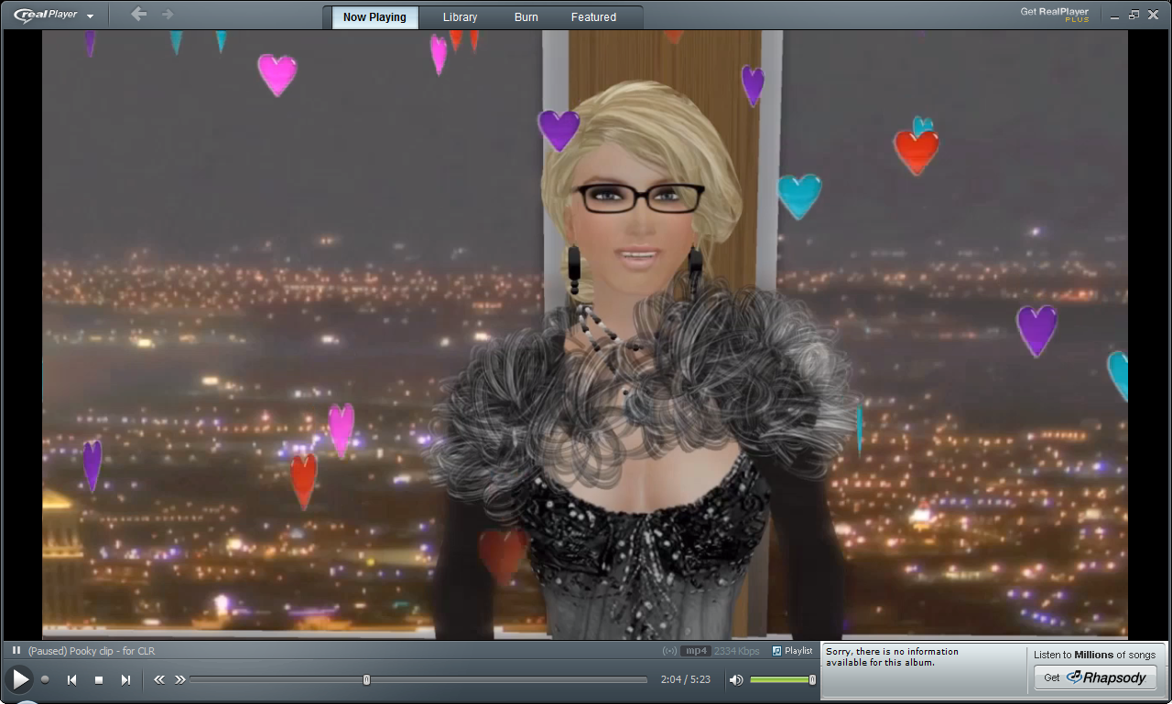
Tension: Confidence & Humility
Confidence in self as producer

Slide 11
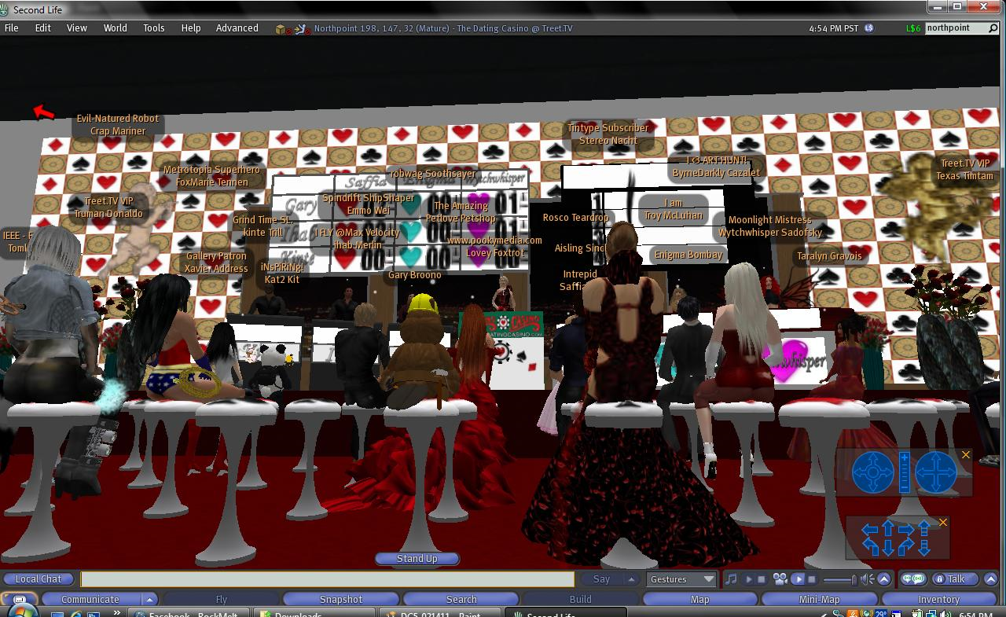
Tension: Confidence & Humility
Humility by recognizing power of audience

Slide 12
Tension: Confidence & Humility
Vision: VWTV requires actions of unseen but not unfelt masses
  Perhaps positions herself as confident because saw how to utilize this new paradigm to create egalitarian ideal
Responses are in ideology of social media
  Positions herself as producer in humbled position to her audiences
    In position to bring something to audience, to serve them, to prepare them

Slide 13
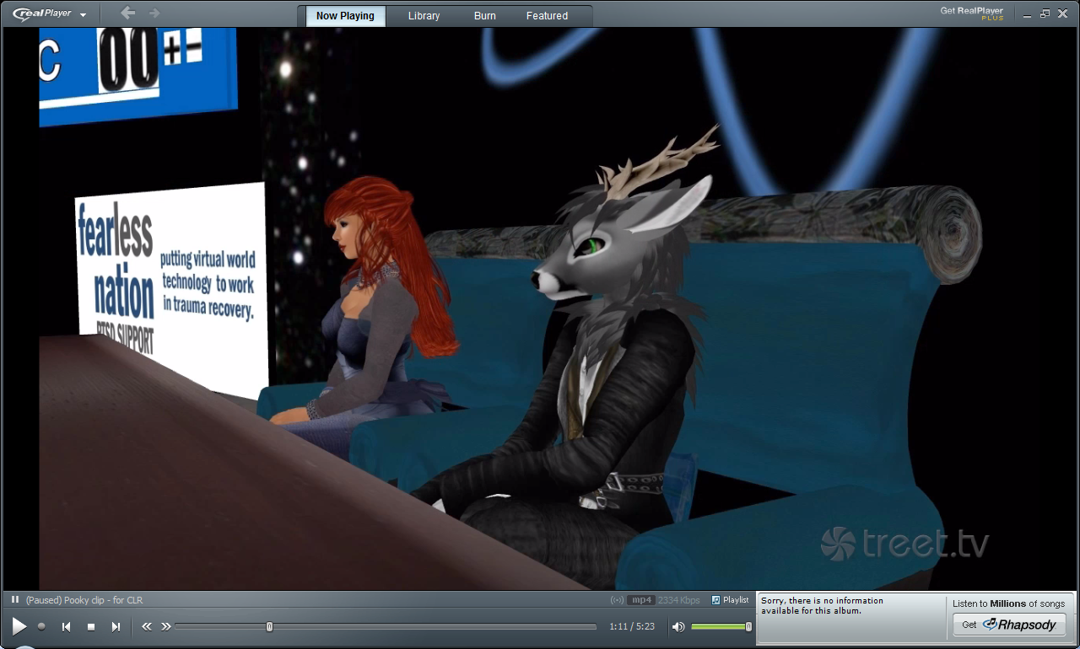
Tension: Powerful & Disempowered
Any power has, from dialogue with audience, production crew

Slide 14
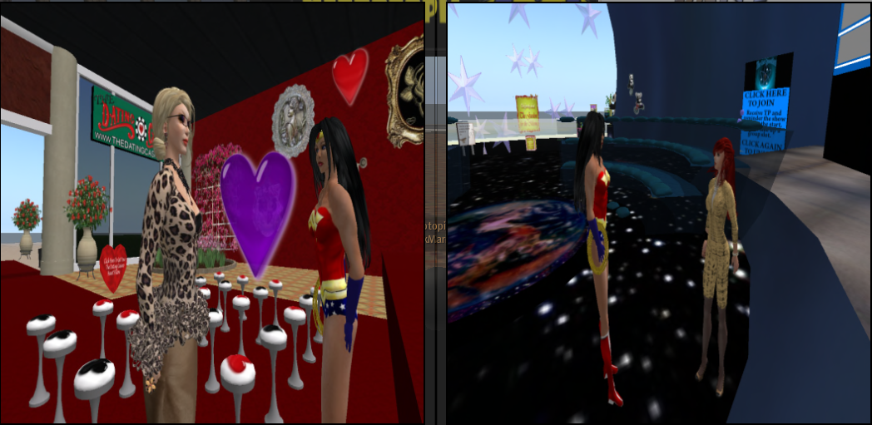
Tension: Powerful & Disempowered
Own agency with virtual worlds structures gave audience space in which be agentic

Slide 15
Tension: Powerful & Disempowered
Virtual worlds empower humans through requirements for engagement
But technology cannot overcome human nature.
  Human nature associated with power
Creates the space, encourages participation.
This power dynamic, associated with traditional media, lessened in Web 2.0 media
  Space created by producer to encourage & require participation
Power dynamic exists, due to requirement for structure to exist
  Not as predominant as other producer-audience relationships

Slide 16
Discussion
Descriptions & tensions indicate how endorse "build it, and let them create".
  Positioned self as producer within tension of Web 2.0 dual identity of "producer" and "user“ (Bruns, 2008; Ross, 2008).
  Striving for egalitarian potential
    empowered by technology
    disempowered compared to TV producer-audience relationship
Similar to other Internet entrepreneurs
  Seek to capitalize on structure of Web 2.0 tech:
    Generate enough interest amongst consumers to use them to propagate enterprise

Slide 17
Future Directions
How much does this study reflect:
  Experiences other VWTV?
  Experiences other Web 2.0 entrepreneurs?
What about the audience?
  How respond/receive such programming?
  What leads to want to engage?

Slide 18
References
Benford, S., Greenhalgh, C., Craven, M., Walker, G., Regan, T., Morphett, J., Wyver, J. & Bowers, J. (1999). Broadcasting On-Line Social Interaction as Inhabited Television. In S. Bødker, M. Kyng, and K. Schmidt (eds.). Proceedings of the Sixth European Conference on Computer-Supported Cooperative Work, J2-16 September 1999, Copenhagen, Denmark, (p. 179-198.) Netherlands: Kluwer Academic Publishers
Bruns, A. (2008). Reconfinguring television for a networked, produsage context. Media International Australia, 126, p. 82-94
Craven, M., Benford, S., Greenhalgh, C., Wyver, J., Brazier, C., Oldroyd, A., et al. (2000). Ages of avatar: Community building for inhabited television. In Proceedings of the Third International Conference on Collaborative Virtual Environments (CVE'00) (pp. 189–194). New York: ACM Press.
Ross, S. M. (2008). Beyond the Box: Television and the Internet. Malden, MA: Blackwell Publishing.
Van den Bergh, J., Bruynooghe, B., Moons, J., Huypens, S., Hemmeryckz-Deleersnijder, B. & Coninx, K. (2007). Using high-level models for the creation of Staged Participatory Multimedia Events on TV. Multimedia Systems, 14 (2), p. 89-103.

